Slide 1
Covid 19 Data Analysis
File created on: 9/24/2022 7:21:10 AM

Slide 2
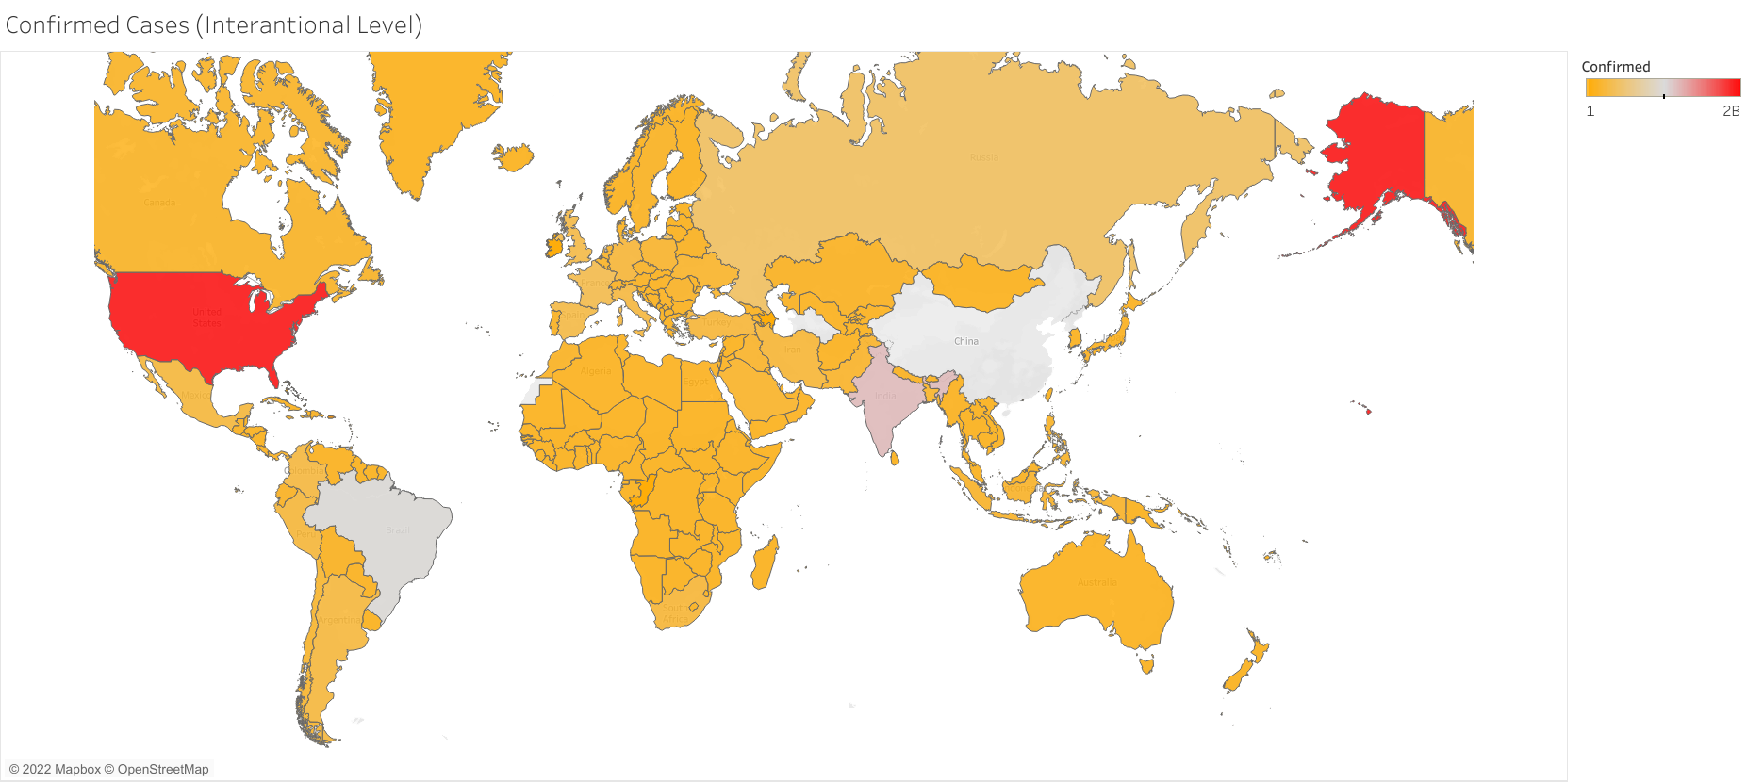

Slide 3
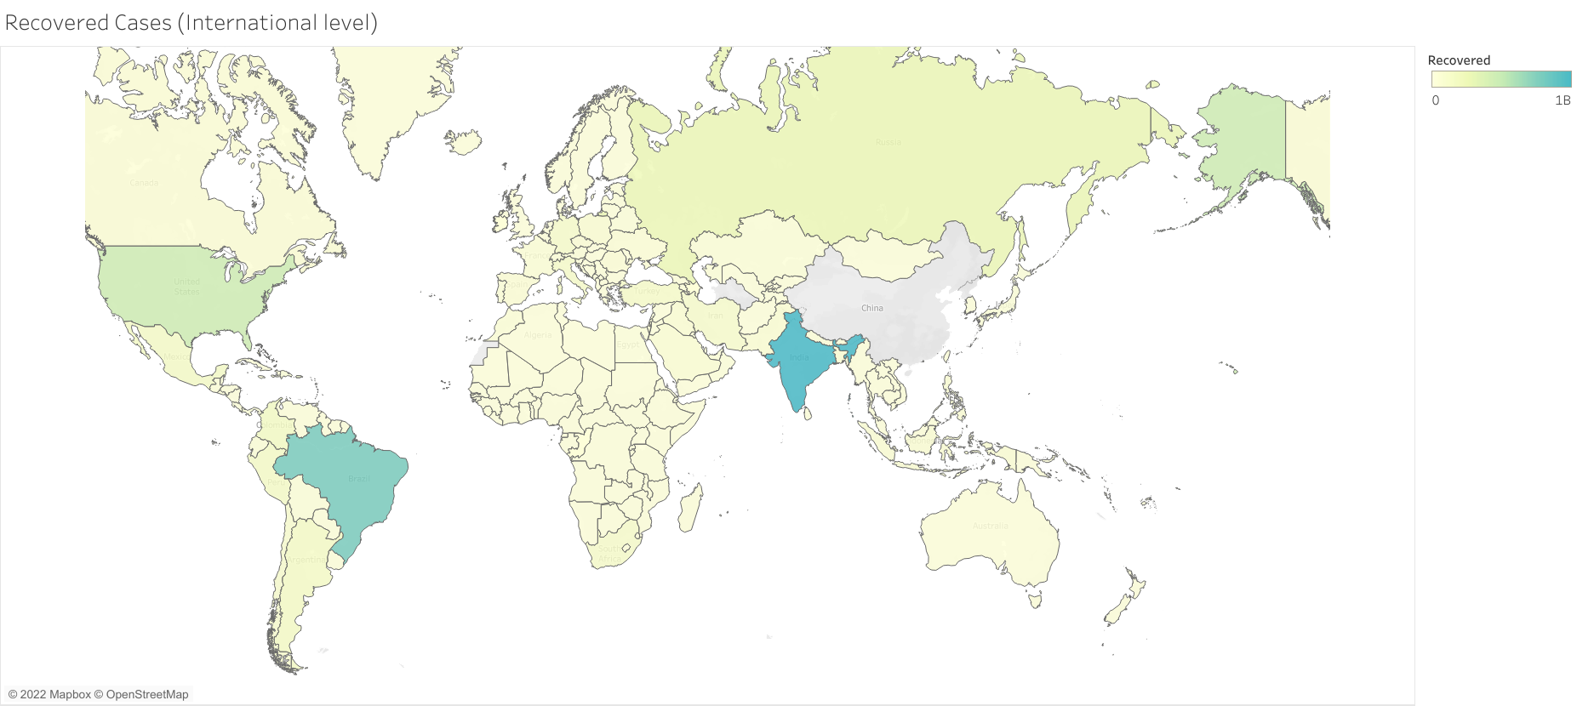

Slide 4
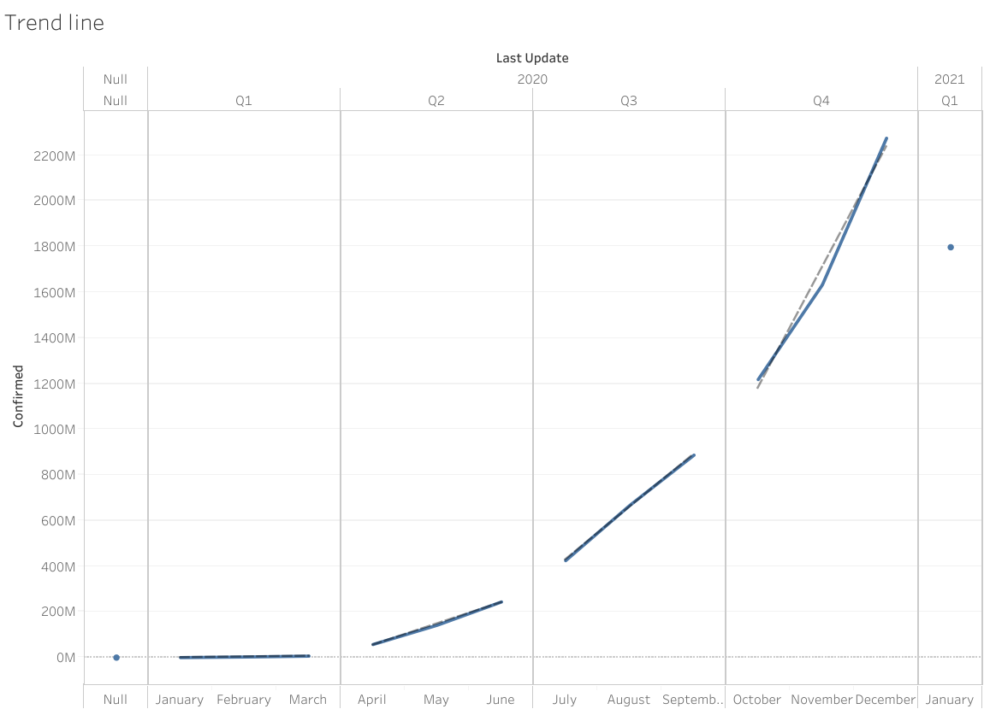

Slide 5


Slide 6


Slide 7


Slide 8
